Slide 1
General Concepts
The Universe began with an explosion, the big bang, over 13 billion years ago.
Our galaxy, the Milky Way, contains billions of stars and the universe contains billions of galaxies.
Stars differ from each other in size, temperature and age. Our Sun is a medium-sized star.

Slide 2
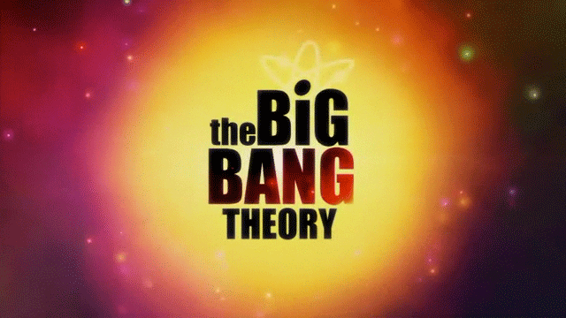
Evidence to support the...

Slide 3
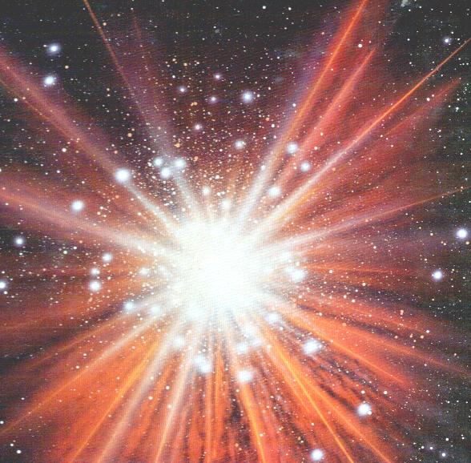
What is the Big Bang Theory?
13.7 billion years ago the universe formed when an infinitely dense point suddenly and rapidly expanded in a single moment.

Slide 4
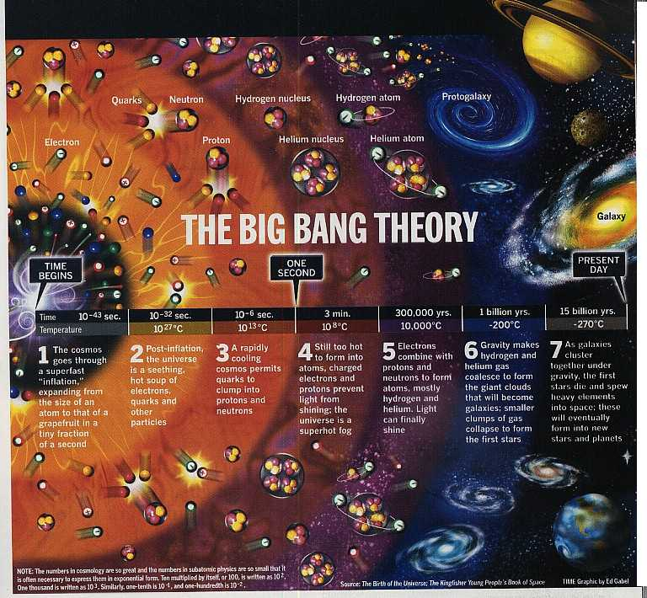
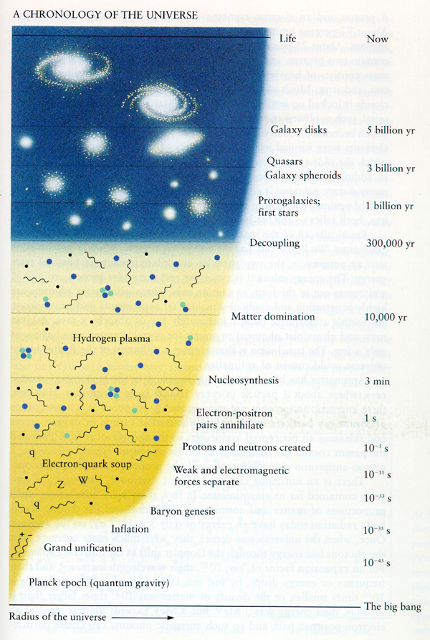

Slide 5
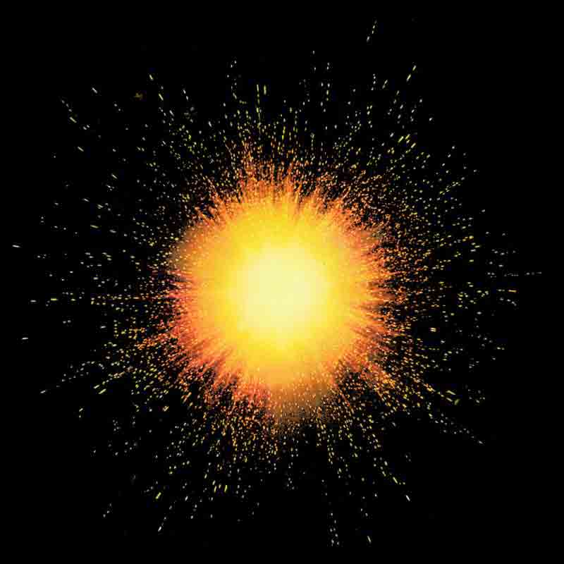
Time begins
The universe begins ~13.7 Billion years ago
The universe begins as the size of a single atom
The universe began as a violent expansion
All matter and space were created from a single point of pure energy in an instant

Slide 6
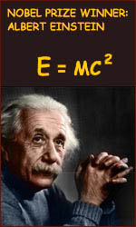
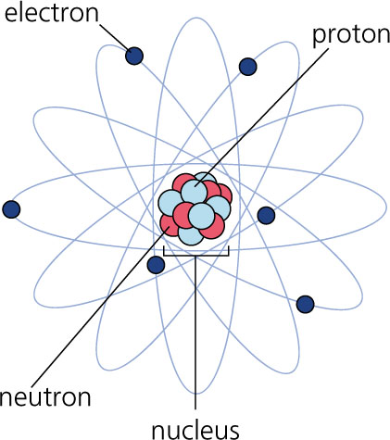
^{~ 3 minutes after big bang}
The universe has grown from the size of an atom to larger than the size a grapefruit
E=mc²
energy froze into matter according to Albert Einstein’s equation.
This basically says that like snowflakes freezing, energy forms matter into clumps that today we call protons, neutrons and electrons.
These parts later form into atoms

Slide 7
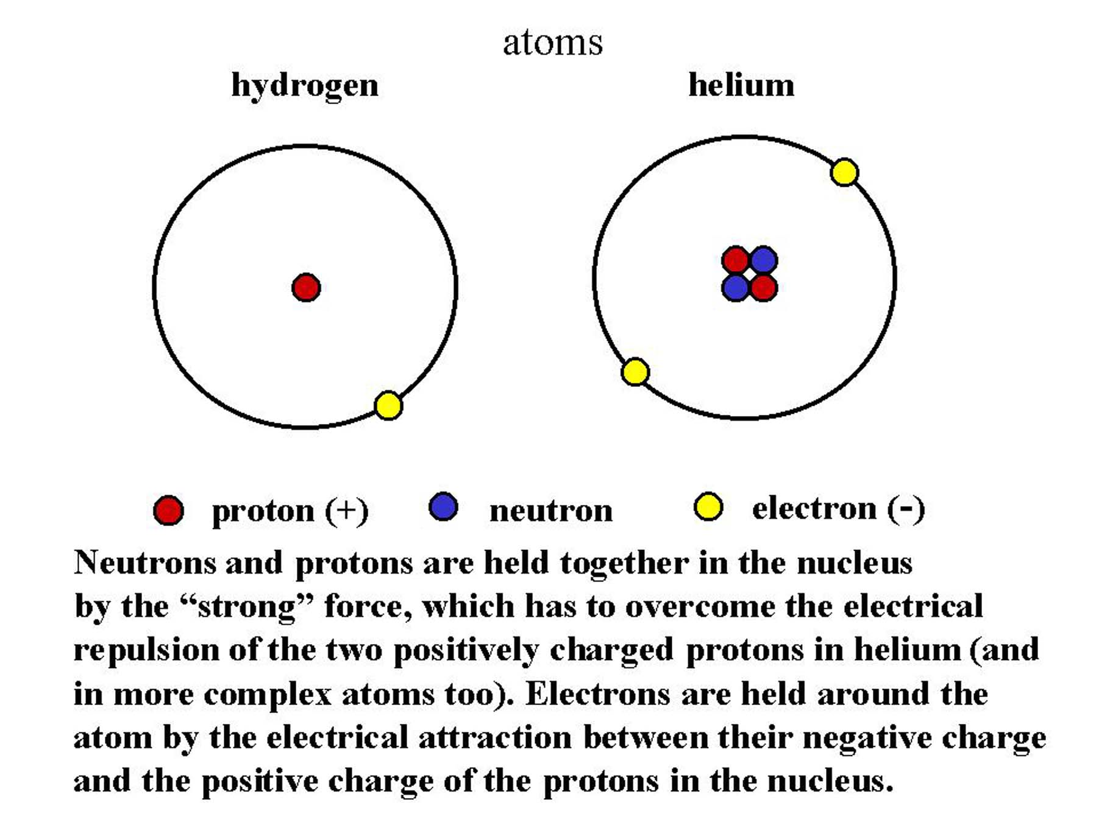
~ Several hundred thousand years after Big Bang
ATOMS form (specifically Hydrogen and its isotopes with a small amount of Helium.)
The early Universe was about 75% Hydrogen and 25% Helium. It is still almost the same today.

Slide 8
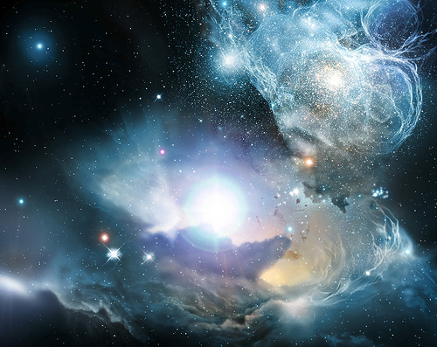
~200 to 400 million years after Big Bang
1st stars and galaxies form

Slide 9
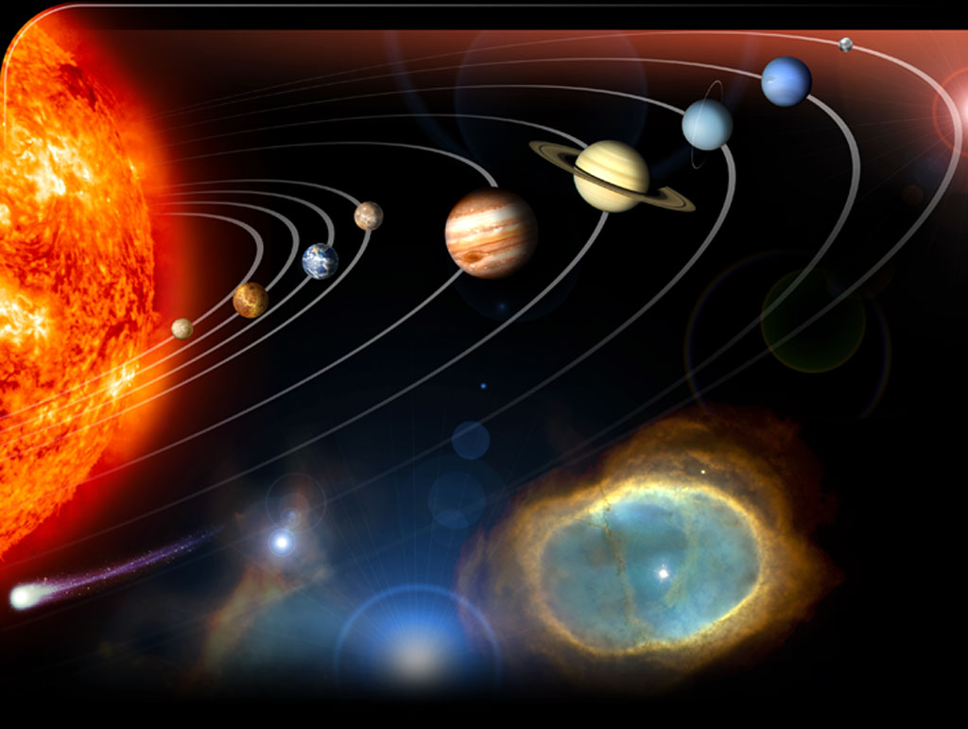
~ 4.6 billion years ago
Our Solar system forms

Slide 10
Misconceptions about the Big Bang
there was no explosion; there was (and continues to be) an expansion
Rather than imagining a balloon popping and releasing its contents, imagine a balloon expanding: an infinitesimally small balloon expanding to the size of our current universe
we tend to image the singularity as a little fireball appearing somewhere in space
space began inside of the singularity. Prior to the singularity, nothing existed, not space, time, matter, or energy - nothing.

Slide 11
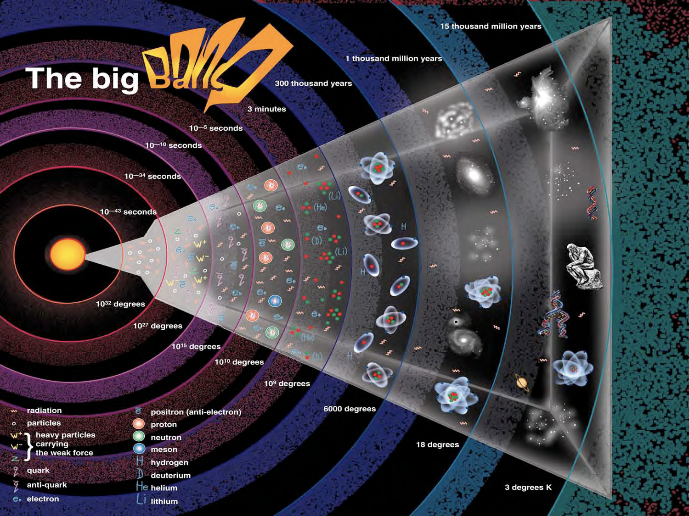
Notes:
Formation of the Big Bang
(Brian Cox)

Slide 12
Evidence for the Big Bang

Slide 13
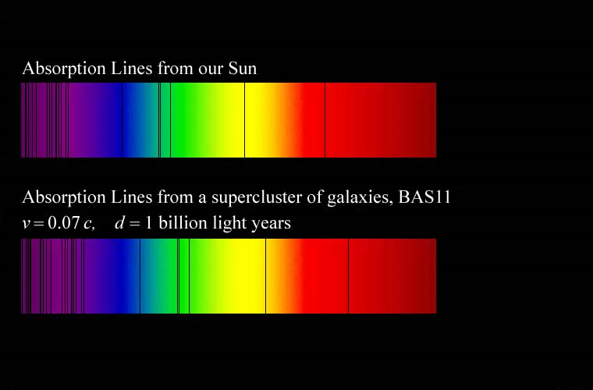
Evidence to Support the Theory
1.Redshift Spectra and Hubble’s Law
Edwin Hubble observed the line spectra from many different galaxies in the sky
most of the spectra for the galaxies were shifted towards the red end of the spectrum – a redshift
Hubble concluded that if most of the galaxies were redshifted, they must be receding in all directions and the universe is expanding from a single point – BIG BANG

Slide 14
Notes:
Electromagnetic spectrum
(NASA)

Slide 15
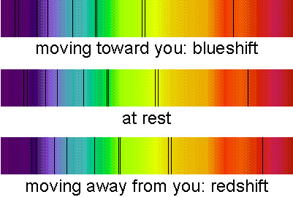
Determining Star Motion
Doppler Effect – the apparent shift in the wavelength of energy from objects as they move toward or away from the observer.
red shift – object is moving away from you
the apparent shift toward the red end of the EM spectrum
blue shift – object is moving towards you
the apparent shift toward the blue end of the EM spectrum
BLUE
end of the Spectrum
RED
end of the Spectrum

Slide 16
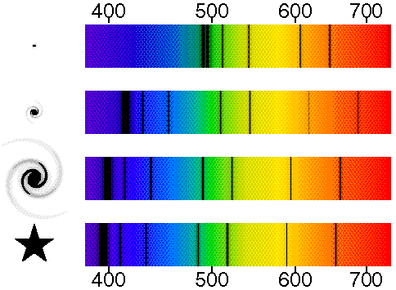
The farther a galaxy is away from Earth, the greater the red-shift. Therefore, galaxies far away are moving away faster!

Slide 17
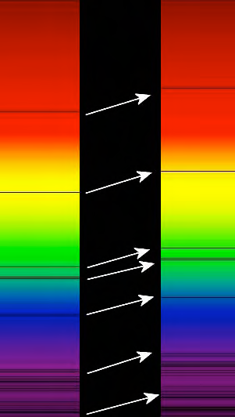
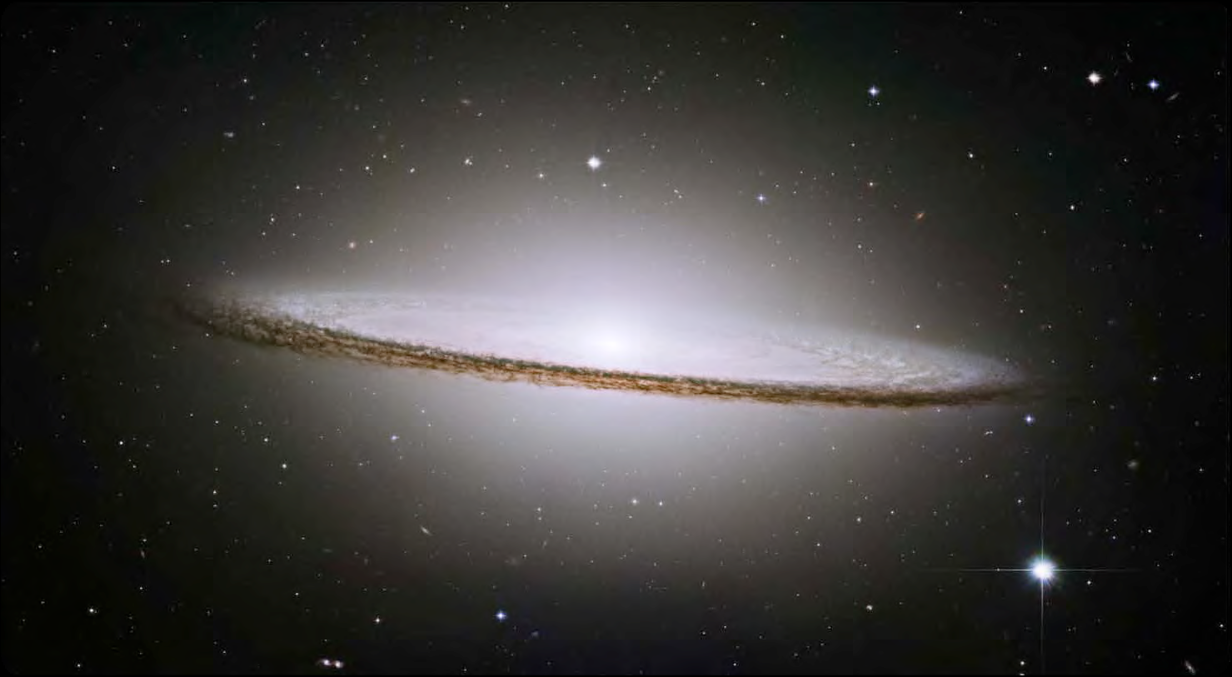
Hydrogen Iron Sodium Hydrogen Oxygen
Notes:
Line spectra and red-shift
(NASA)

